Slide 1

Swiggy Recommendation System – Streamlit Demo

Slide 2
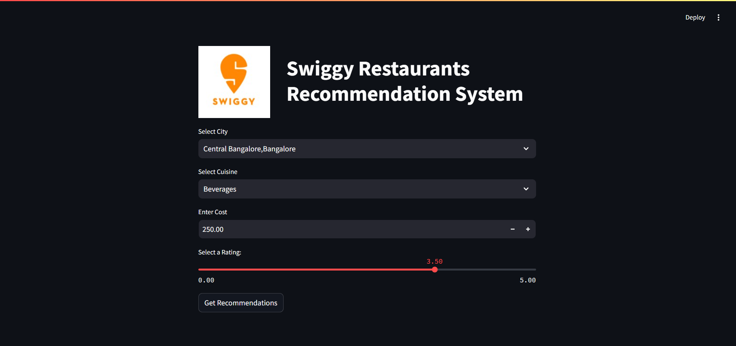

Slide 3
